Slide 1
Statistical programming in R
Part 2

Slide 2
Topics covered
Point estimation
Confidence interval
Bootstrap

Slide 3
Point estimation

Slide 4
Point estimation
One of the main goals of statistics is to estimate unknown parameters
To approximate these parameters, we choose an estimator, which is simply any function of randomly sampled observations

Slide 5
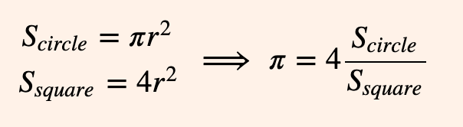
Point estimation
To illustrate this idea, we will estimate the value of π by uniformly dropping samples on a square containing an inscribed circle. Notice that the value of π can be expressed as a ratio of areas.

Slide 6
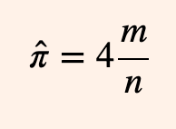
Point estimation
We can estimate this ratio with our samples. Let m be the number of samples within our circle and n the total number of samples dropped. We define our estimator π̂ as:

Slide 7
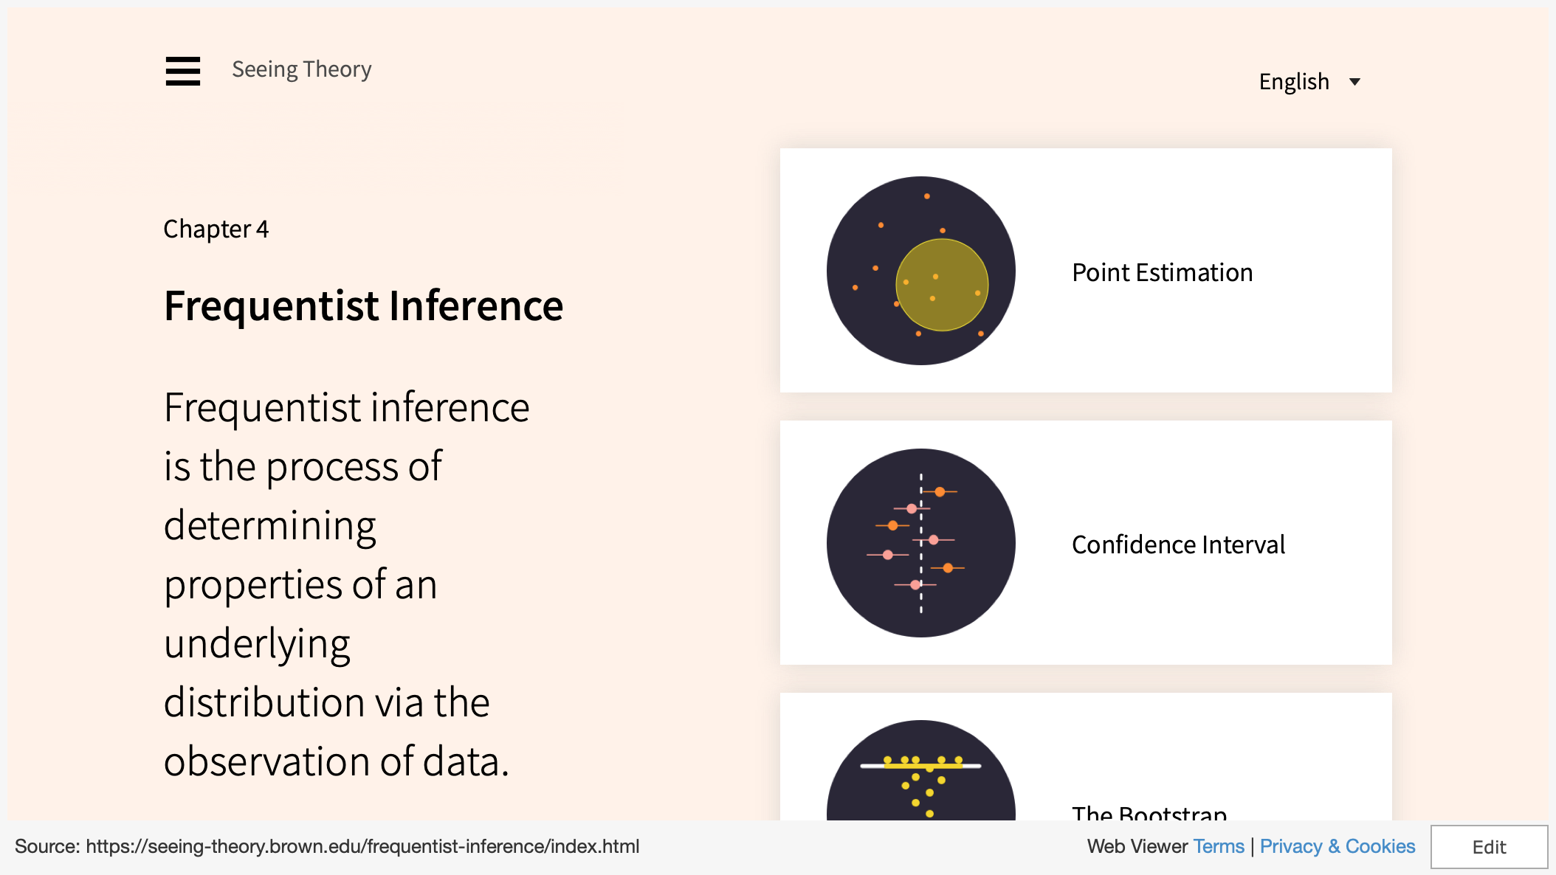
https://seeing-theory.brown.edu/basic-probability/index.html - section1
Notes:
https://seeing-theory.brown.edu/basic-probability/index.html#section1https://seeing-theory.brown.edu/basic-probability/index.html#section

Slide 8
Point estimation in R
We may also sample from a reference population and see if our sample mean is a good approximation to the reference population
In this case, we say that the sample mean is a point estimator of the true population parameter
Let us sample 10 samples from a normal distribution with mean of 0 and standard deviation of 1
sample <- rnorm(10, 0, 1)
mean(sample)
Is this sample mean close to the true population mean?
Now, try with 100, 1000 and 10,000
Are we getting closer?

Slide 9
Confidence interval

Slide 10
Confidence interval
Another way of estimating parameter from a population is to define a range of possible values instead of just using 1 point estimate
This range is an interval, and is associated with a confidence level
The confidence level is the probability that this range will contain the true population parameter
This is known formally as the confidence interval (CI)

Slide 11
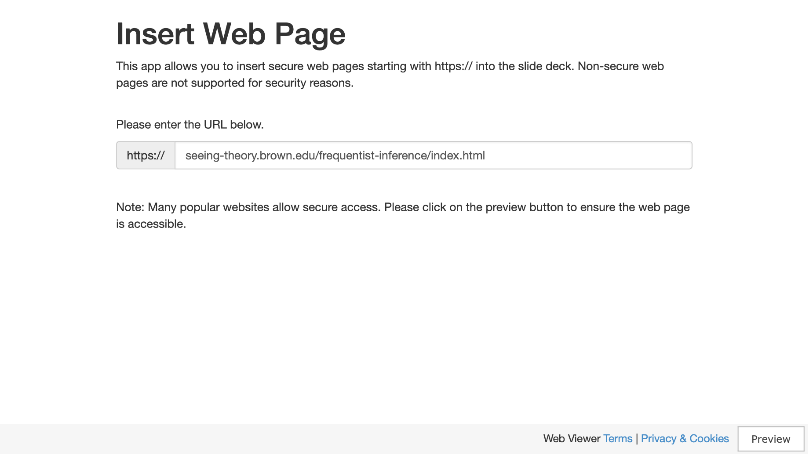
https://seeing-theory.brown.edu/basic-probability/index.html - section1
Notes:
https://seeing-theory.brown.edu/basic-probability/index.html#section1https://seeing-theory.brown.edu/basic-probability/index.html#section

Slide 12
Confidence interval in R
We will make some assumptions for what we might find in an experiment and find the resulting confidence interval using a normal distribution.
In this example we will use a 95% confidence level and wish to find the confidence interval.

Slide 13
Confidence interval in R
x = c(9.0,9.5,9.6,10.2,11.6)
t.test(x)
outcome <- t.test(x)
outcome$conf.int

Slide 14
Bootstrap

Slide 15
Bootstrap
The computational technique known as the Bootstrap provides a convenient way to estimate properties of an estimator via resampling.
In this example, we resample with replacement from the empirical distribution function in order to estimate the standard error of the sample mean.

Slide 16
https://seeing-theory.brown.edu/basic-probability/index.html - section1
Notes:
https://seeing-theory.brown.edu/basic-probability/index.html#section1https://seeing-theory.brown.edu/basic-probability/index.html#section

Slide 17
Bootstrap in R
Using rnorm and possibly a loop or two. Write a function called my_firstbootstrap(n,m,x,y), where n is the sampling size and m is the number of resampling. x and y are the means and sd of a normal distribution
Devise a way to evaluate the bootstrap outcomes as you increment sampling size, and number of resampling
Hint: you can evaluate the sampling mean to the true population mean

Slide 18
Bootstrap in R
my_firstbootstrap(10,100,10,1)
my_firstbootstrap(100,100,10,1)
my_firstbootstrap(1000,100,10,1)
my_firstbootstrap(10,500,10,1)
my_firstbootstrap(10,1000,10,1)
my_firstbootstrap(10,2000,10,1)
my_firstbootstrap(10,3000,10,1)
Notes:
my_firstbootstrap <- function(n,m,x,y)
{
sampling_means <- c()
for (i in 1:m)
{
sampling_means <- append(sampling_means, mean(rnorm(n, x, y)))
}
return(mean(sampling_means))
}

Slide 19
End of Segment
Let’s take a break

